Slide 1
Pulus Widith Modulatoin
Mostafa Wageh Mostafa

Slide 2
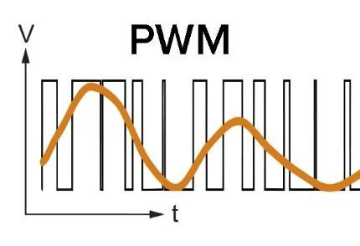
1-Introduction
1-Microcontroller is a digital device where the logic output is 0 or 1 which mean that the digital output voltage is either 0 or 5 voltage
2-here it more flexible to build electronic circuits , control algorithm and process the data digitally

Slide 3
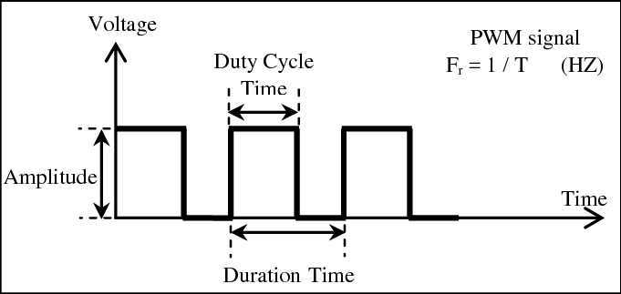
2-Main Concept
The duty cycle is simply how much of the overall pulse time is taken up by the ON time.
Duty Cycle = On Time / Total Period
Frequency = 1/ Total Period

Slide 4
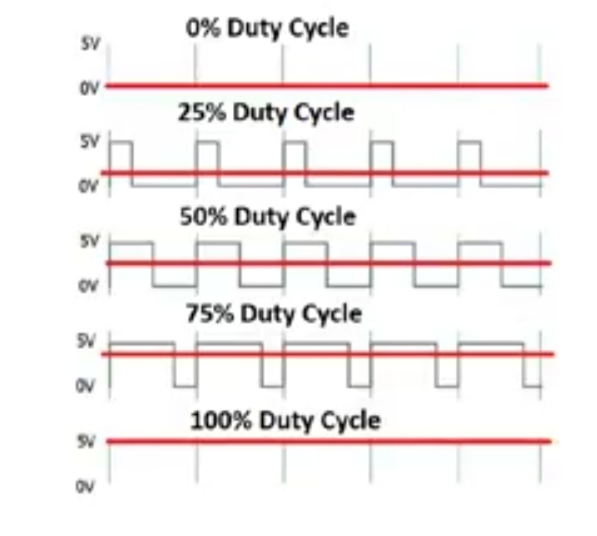
2-Main Concept

Slide 5
3-Why To use PWM
Analog Signal Generation: Varying duty cycle produces analog-like voltage control.
Motor Speed Control: Adjusting PWM duty cycle regulates motor speed.
LED Dimming: Control LED brightness by varying PWM duty cycle.
Switching Power Supplies: PWM crucial for efficient switching power supply designs.
Audio Signal Generation: PWM can be used for sound generation in audio applications.
Data Transmission: PWM employed in communication protocols, e.g., infrared remote control.
Efficiency: Enables efficient power control, especially in motor and power supply applications.
Temperature Control: Used to regulate power to heating elements for temperature control.

Slide 6
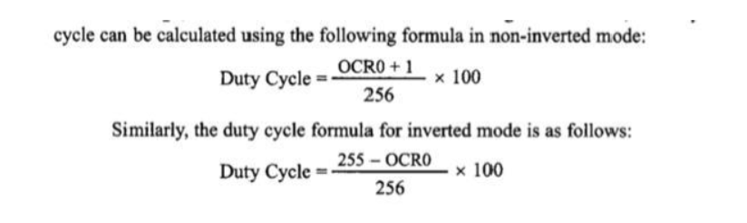
4-Project Configuration
PD 7 is the Output Pin (internal PWM output) which Used PWM driver and Fast PWM for Not inverting mode , No Prescaling (PWM no Prescaling)
PD 6 is the Output Pin : TIMER1(ICU Driver) – Measuring with input Capture unit (ICU)

Slide 7
4-Project Configuration
PD 7 is the Output Pin (internal PWM output) which Used PWM driver and Fast PWM for Not inverting mode , No Prescaling (PWM no Prescaling)
PD 6 is the Output Pin : TIMER1(ICU Driver) – Measuring with input Capture unit (ICU)

Slide 8
5-Project Steps
Collected the DIO, Timer, and LCD modules we wrote in the course
Write the LCD functions and define each pin
Write the PWM function that calculates the frequency and the duty cycle and update the value on the LCD
Write the PWM Drawer function that draws wave
Check for errors and debug
Flash the project on the microcontroller

Slide 9
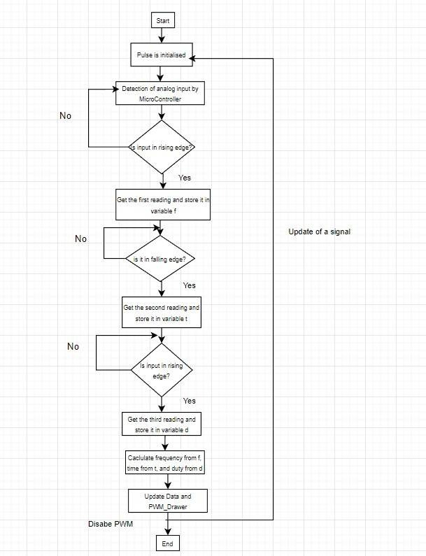
6-Project Flowchart: Describe the Main Functions

Slide 10
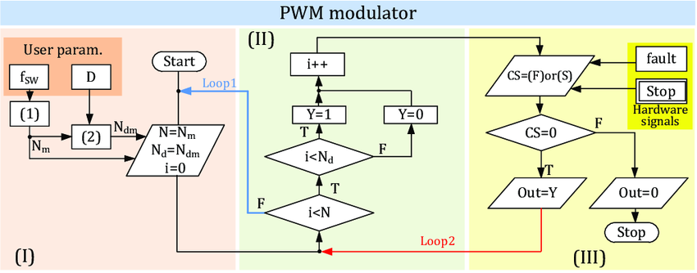
6-Project Flowchart: Describe the Main Functions

Slide 11
7-Layered Architecture
Application Layer
PWM DRAWER
Hardware Abstraction Layer
G-LCD
Micro-Controller Abstraction Layer
DIO
GPT
PWM
ICU

Slide 12
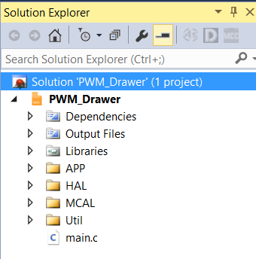
7-project Modularity
1-App
2-HAL
LCD (16x2) module
3-MCAL
PWM (TIMER2 peripheral)
ICU ( TIMER1 peripheral)
4-Util

Slide 13
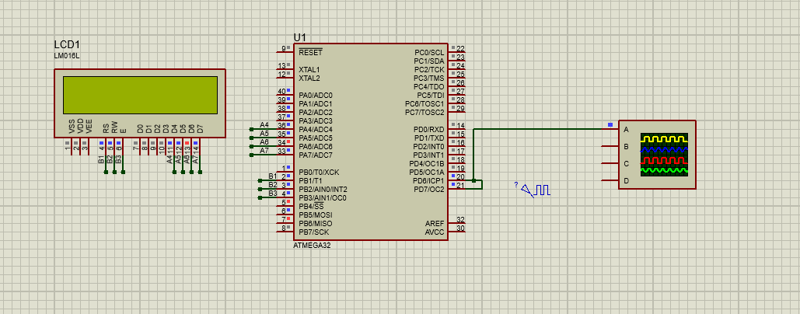
8-project Simulation

Slide 14
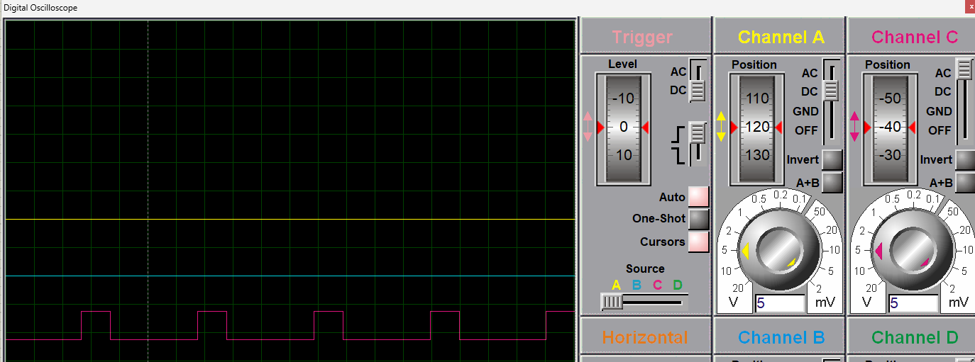
8-project Simulation

Slide 15
Conclusion
In conclusion, the Pulse Width Modulation (PWM) drawer project offers a versatile and efficient solution for controlling electronic devices and systems. The utilization of PWM technology provides several benefits and expands the range of applications across various domains.
Benefits:
Precision Control: PWM allows for precise control over the average power delivered to a load, enabling fine adjustments in various applications such as motor speed control, LED dimming, and temperature regulation.
Energy Efficiency: The ability to modulate power delivery efficiently contributes to energy savings, making PWM an environmentally friendly choice for systems where power consumption is a critical consideration.
Analog Signal Simulation: PWM enables the generation of analog-like signals through the manipulation of duty cycles, providing a digital means to simulate continuous voltage levels.
Versatility: The project's PWM drawer offers a flexible tool for diverse applications, ranging from motor speed regulation to audio signal generation, showcasing its adaptability in different electronic systems.
Reduced Heat Generation: In scenarios like LED dimming and switching power supplies, PWM helps minimize heat generation by allowing devices to operate at lower power levels when full power is unnecessary.

